Slide 1


Start Smart 1.0
3rd Grade
Lesson 11

Slide 2

ELD Objective
ELD Objective: Students will be able to engage in a Constructive Conversation using the Constructive Conversation Skill of NEGOTIATE, by taking turns, sharing ideas and making ideas clearer with a partner based on a visual text.

Slide 3
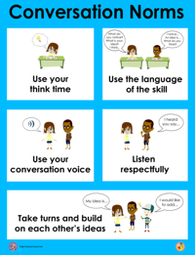
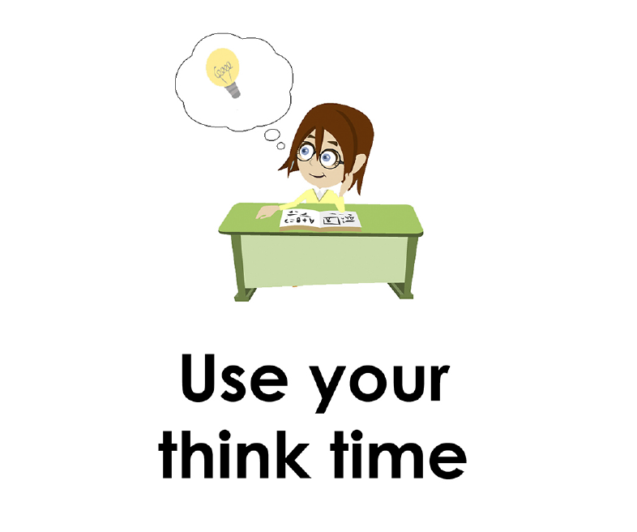
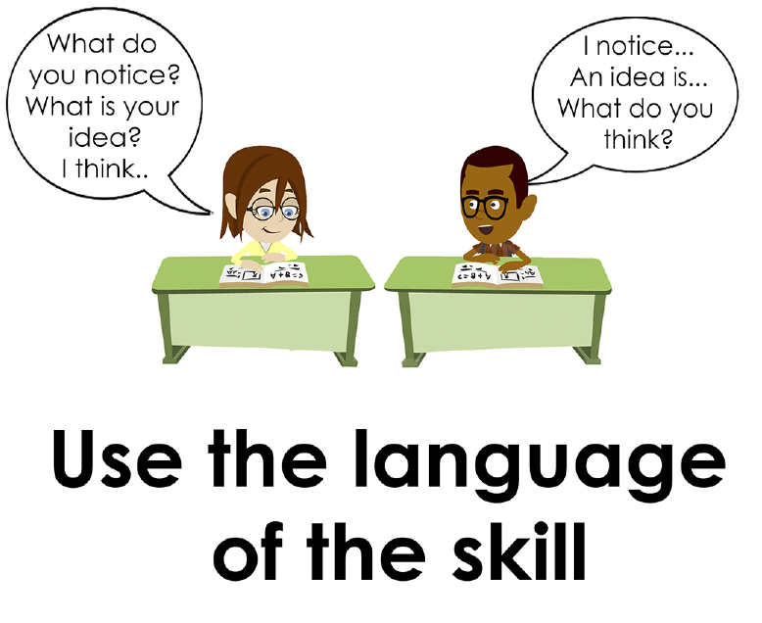
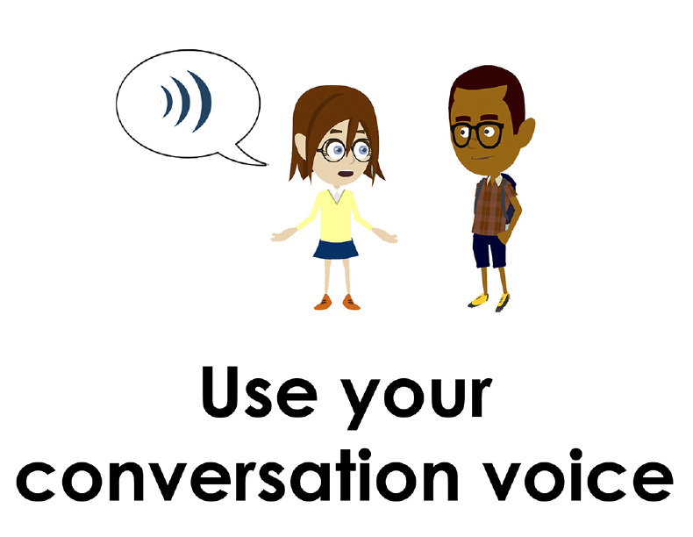
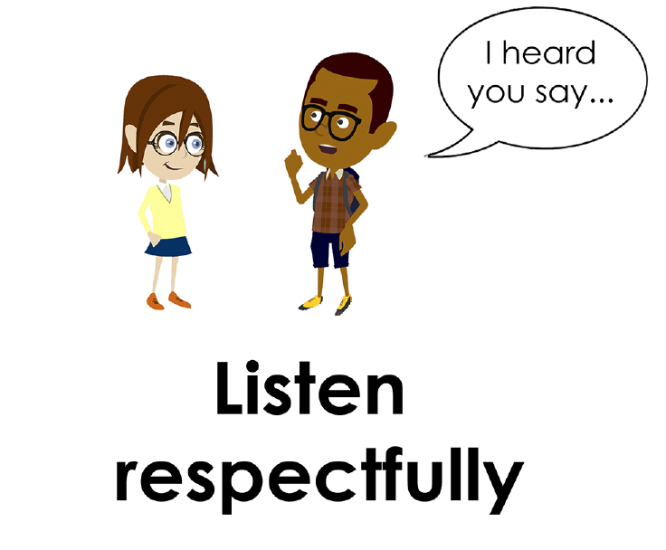
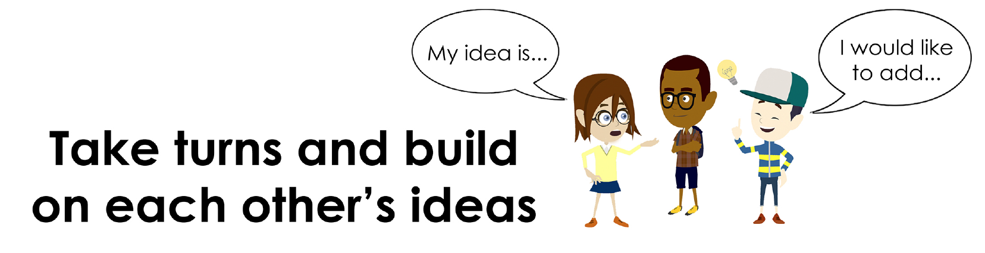
Conversation Norms Poster
  Use your think time
  Use the language of the skill
  Use your conversation voice
  Listen respectfully
  Take turns and build on each other’s ideas

Slide 4
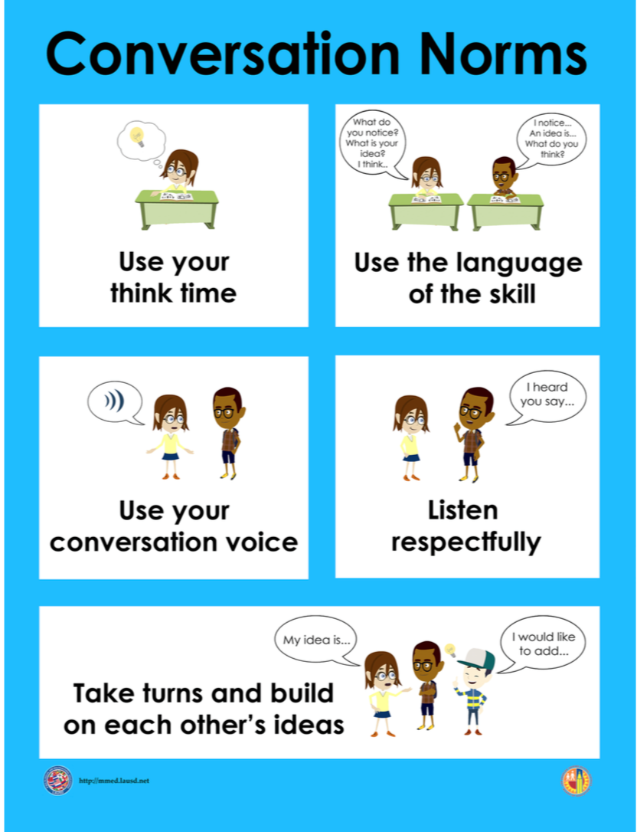
Notes:
The focus today is:
Use your think time
Use the language of the skill

Slide 5
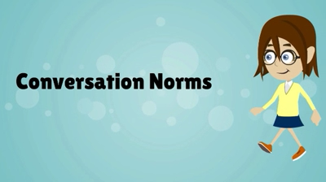
Conversation Norms
Notes:
Show Constructive Conversation Norms Video as a review of all norms

Slide 6
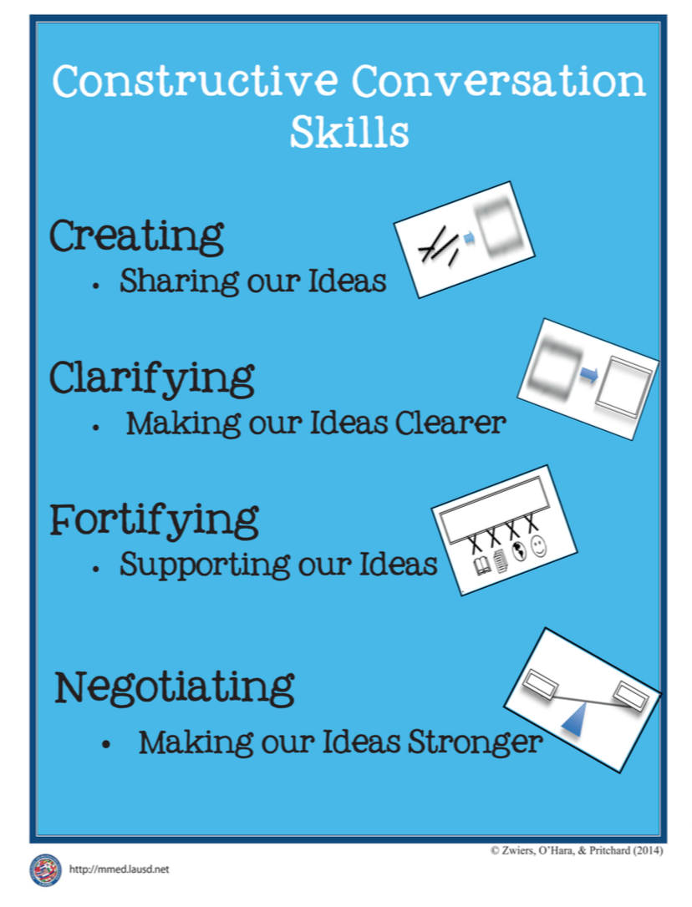
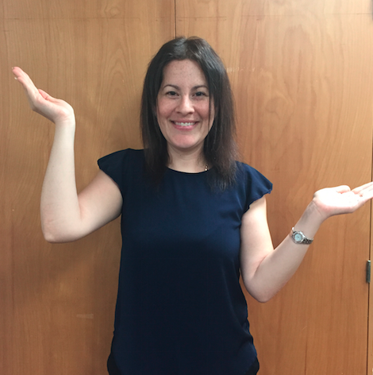
Hand Gesture and Phrase- NEGOTIATE
Making our Ideas Stronger
Notes:
Model NEGOTIATE and have participants repeat with you:
Place hand, palm down in front of you as if putting an idea on the table. Use four fingertips of the other hand to support the palm.

Slide 8
Prompt: What is an important idea from this text? Start by stating your claim. Support your claim and come to a consensus.
TEACHER VISUAL TEXT

Slide 9


Listen to the Model Constructive Conversation
  Use your think time to study the visual text.
Listen actively to what two partners say to each other.
Notes:
Provide a copy of the Model Script to the volunteer and allow time beforehand for student to review the script. Suggestions for reading the script:
● Show a video of students having the model conversation (optional)
● Student volunteer and teacher read model script
STUDENT LISTEN ACTIVELY

Slide 10
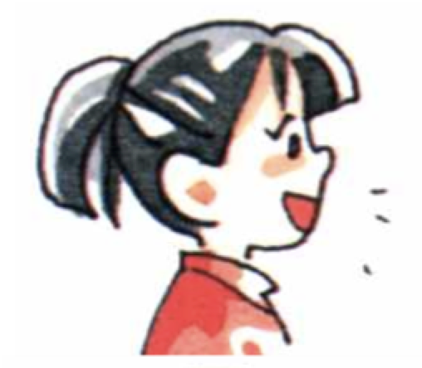
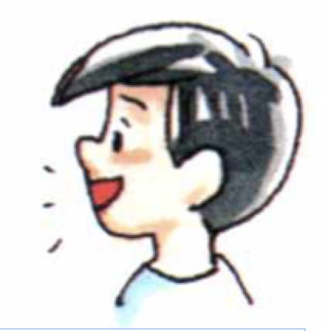
Visual Text Model
What is an important idea from this text? Start by stating your claim. Support your claim and come to a consensus.
Partner A: My claim is that when you are making something, everyone needs to work together. What is an important idea from this visual text?
Partner A: I notice that the kids are bringing items to Amanda who is rolling the dough. What evidence do you have to support your claim?
Partner A: I notice that in the visual text, the girl is making the pies and the others are helping her. They are all bringing different things to make pies. The big boy is carrying a shelf, another boy is carrying a sign and the little boy is bringing buckets of fruit.
Partner A: An important idea is that when making something it is best to work together to get different things done. What do you think?
Partner B: Another important idea is that more things get done when you help each other. What evidence can you use to support your claim?
Partner B:I notice one child has a shelf, another child has a sign and the little boy has buckets of fruit. I think they are bringing items that will help Amanda display her pies for sale. What other evidence do you have that supports your claim?
Partner B:I agree with you that they are all working together. By bringing all the items together they are working together. Can we come to a consensus?
Partner B: Let’s come to a consensus. An important idea from this visual text is that working together helps to get more things done.

Slide 12
Listen to the Non-Model Constructive Conversation
  Use your think time to study the visual text.
Listen actively to what two partners say to each other.
Notes:
Provide a copy of the Non-­‐‑Model Script to the volunteer and allow time beforehand for student to review the script. Suggestions for reading the script:
● Show a video of students having the model conversation (optional)
● Student volunteer and teacher read model script
STUDENT LISTEN ACTIVELY

Slide 13
Visual Text Non- Model
What is an important idea from this text? Start by stating your claim. Support your claim and come to a consensus.
Partner A: An important idea is they are making cakes.
Partner A: In the text it shows the kids working together to get things for the cake. I see buckets of fruit, a sign and a shelf that all the children are bring to the big girl.
Partner A: The kids all have smiles on their faces and seem happy to help the girl with the red hair.
Partner A: I disagree. I think it is about making pies. I see they are making pies because on the sign it says “Amanda’s pies”.
Partner B: I think they are making pies. I notice pies on the table.
Partner B: I think that they will make four delicious pies because I see four balls of dough on the table.
Partner B: I agree and my opinion is they are all helping to make cakes.
Partner B: Okay. I agree.

Slide 14
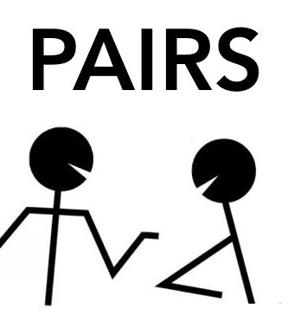
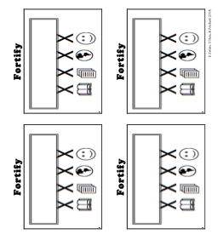
Constructive Conversation Game
PROMPT:
What is an important idea from this text? Start by stating your claim. Support your claim and come to a consensus.
Rules of the game:
Each of you needs 1 CREATE, 1 CLARIFY, 1 FORTIFY, and 2 NEGOTIATE cards
Each of you will play one card as you share an idea. You will continue taking turns until all cards are placed in the middle.
If you’re done early repeat the process for an additional round.
Remember to use the Constructive Conversation Norms and Skills as you play the game.
Notes:
You are now going to have the opportunity to practice the Constructive Conversation Skill NEGOTIATE while playing a game.
Explain the rules of the Constructive Conversation Game to students.

Slide 15
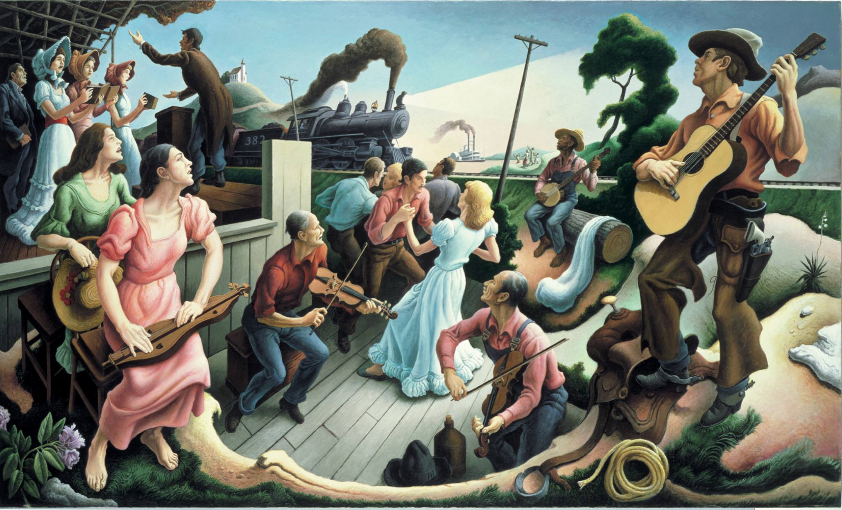

Prompt: What is an important idea from this text? Start by stating your claim. Support your claim and come to a consensus.
TEACHER COLLECTS LANGUAGE SAMPLE SPF 1.0
STUDENT VISUAL TEXT
Notes:
Display the Student Visual Text
Direct students to use their Think Time
As the students play the game, the teacher listens and selects two students who will replay the game in front of the class to serve as models.
This is an opportunity to capture a language sample.

Slide 16


CONSTRUCTIVE CONVERSATION
FISHBOWL MODEL
PROMPT: What is an important idea from this text? Start by stating your claim. Support your claim and come to a consensus.
Listen actively to what two partners say to each other.
FORMATIVE ASSESSMENT– TEACHER COLLECTS LANGUAGE SAMPLE SPF 1.0
Notes:
The two selected students will replay the game in front of the class and serve as models.
Student Progress Form (SPF)-­‐‑ Constructive Conversation Language Sample The teacher will collect a language sample from the two students on the Student Progress Form (SPF)-­‐‑ Constructive Conversation Language Sample to be used in Lesson 2. The language sample must be at least four turns in length. (Each turn includes both Partner A and B sharing

Slide 17
WRAP-UP
How did we meet today’s objective of using the Constructive Conversation Skill of NEGOTIATE?
How did you:
    Use your think time?
    Use the language of the skill
  Work with your conversation partner to do the following:
    Identify three things that you did to meet today’s objective
    Share and explain the three things to your partner
Notes:
Teacher will review ELD objective.
Today we engaged in a Constructive Conversation using the Constructive Conversation Skill-­‐‑NEGOTIATE. We took turns and shared ideas based on a visual text.
Teacher will ask students the following:
● How did we meet today’s objective of using the Constructive Conversation Skill of NEGOTIATE?
● How did you:
-Use your think time
-Use the language of the skill
● Work with your conversation partner to do the following:
Identify three things that you did to meet today’s objective
Share and explain the three things to your partner
Teacher calls on three students and they tell the class what was done today.

Slide 18
Start Smart 1.0
NEGOTIATE
3rd Grade
Lesson 12

Slide 19
ELD Objective
Students will be able to revise a Non-Model Conversation for the Constructive Conversation Skill- NEGOTIATE in a whole group setting and with a triad.
Notes:
Today we are going to review the Constructive Conversation Skill-­‐‑FORTIFY. When we create, we say what we notice about something.

Slide 20
Notes:
Let’s review the Conversation Norms Poster
Today, we will focus on:
Use the language of the skill
Use your conversation voice
**Give examples for both. Ask for student volunteers to model the two norms.

Slide 21
Conversation Norms
Notes:
Show Constructive Conversation Norms Video as a review of all norms

Slide 22
Hand Gesture and Phrase- NEGOTIATE
Making our Ideas Stronger
Notes:
Model NEGOTIATE and have participants repeat with you:
Place hand, palm down in front of you as if putting an idea on the table. Use four fingertips of the other hand to support the palm.

Slide 23
Prompt and Response Starters
Prompt Starters:
What is your claim…?
What is an important idea…?
Do you agree? Why?
Do you disagree? Why?
Response Starters:
My claim is…
An important idea is…
I agree because…
I disagree because…
Notes:
Display the Visual Text for Teacher Modeling, Negotiate Skill Poster and Listening Task Poster.
To model what a Constructive Conversation looks like we are going to use the visual text and the Listening Task Poster to address the following prompt: What is an important idea from this text? Start by stating your claim. Support your claim and come to a consensus. As we look at the visual text, we will NEGOTIATE, share our own ideas and come to a consensus.
Today I am going to model using the Constructive Conversation Skill of NEGOTIATE using these prompt and response starters. They will help us to communicate our ideas clearly. Have students round robin or chorally read previously charted prompt and response starters:

Slide 25
Prompt: What is an important idea from this text? Start by stating your claim. Support your claim and come to a consensus.
TEACHER VISUAL TEXT
Notes:
Display the Student Visual Text
Direct students to use their Think Time

Slide 26
Listen to the Model Constructive Conversation
  Use your think time to study the visual text.
Listen actively to what two partners say to each other.
Notes:
Provide a copy of the Model Script to the volunteer and allow time beforehand for student to review the script. Suggestions for reading the script:
● Show a video of students having the model conversation (optional)
● Student volunteer and teacher read model script
STUDENT LISTEN ACTIVELY

Slide 27
What makes this a model conversation?
Partner A: My claim is that when you are making something, everyone needs to work together. What is an important idea from this visual text?
Partner A: I notice that the kids are bringing items to Amanda who is rolling the dough. What evidence do you have to support your claim?
Partner A: I notice that in the visual text, the girl is making the pies and the others are helping her. They are all bringing different things to make pies. The big boy is carrying a shelf, another boy is carrying a sign and the little boy is bringing buckets of fruit.
Partner A: An important idea is that when making something it is best to work together to get different things done. What do you think?
Partner B: Another important idea is that more things get done when you help each other. What evidence can you use to support your claim?
Partner B: I notice one child has a shelf, another child has a sign and the little boy has buckets of fruit. I think they are bringing items that will help Amanda display her pies for sale. What other evidence do you have that supports your claim?
Partner B: I agree with you that they are all working together. By bringing all the items together they are working together. Can we come to a consensus?
Partner B: Let’s come to a consensus. An important idea from this visual text is that working together helps to get more things done.
Notes:
Teacher will use questions and the Listening Task Poster to guide students through an analysis of what makes this a Model Constructive Conversation for the skill of NEGOTIATE.

Slide 28
Understanding the Skill of NEGOTIATE
Partner A: My claim is that when you are making something, everyone needs to work together. What is an important idea from this visual text?
Partner A: I notice that the kids are bringing items to Amanda who is rolling the dough. What evidence do you have to support your claim?
Partner A: I notice that in the visual text, the girl is making the pies and the others are helping her. They are all bringing different things to make pies. The big boy is carrying a shelf, another boy is carrying a sign and the little boy is bringing buckets of fruit.
Partner A: An important idea is that when making something it is best to work together to get different things done. What do you think?
Partner B: Another important idea is that more things get done when you help each other. What evidence can you use to support your claim?
Partner B: I notice one child has a shelf, another child has a sign and the little boy has buckets of fruit. I think they are bringing items that will help Amanda display her pies for sale. What other evidence do you have that supports your claim?
Partner B: I agree with you that they are all working together. By bringing all the items together they are working together. Can we come to a consensus?
Partner B: Let’s come to a consensus. An important idea from this visual text is that working together helps to get more things done.
Notes:
Understanding the Skill: Negotiate
Teacher displays or distributes the Model Script from Lesson 11.
Example of Think-Aloud:
Student A:
My claim is that when you are making something, everyone needs to work together. (N) What is an important idea from this visual text? (CL)
Student B:
Another important idea is that more things get done when you help each other. (N) What evidence can you use to support your claim? (F)
Student A:
I notice that the kids are bringing items to Amanda who is rolling the dough. (CR) What evidence do you have to support your claim? (N)
Student B:
I notice one child has a shelf, another child has a sign and the little boy has buckets of fruit. (F) I think they are bringing items that will help Amanda display her pies for sale. What other evidence do you have that supports your claim? (F)
Let’s look at the Model Script to find evidence of the skills of NEGOTIATE, FORTIFY, CREATE, and CLARIFY. How are we using the visual text to guide our conversation?
Let’s look at the last three turns. Read them to yourself as I read them aloud (see example above).
Let’s look at the language of the skill. Look at Student A’s response. How do I know Student A used the skill of NEGOTIATE? I see the language of the skill (underline as noted above). I know this is NEGOTIATE because it is asking to come to an agreement so I will label it with N (Write N next to the response.) Student A is also using evidence from the text to support his idea (Write F next to the response). I also notice that Student B is using the language of the skill to state their claim, so I will label it with N (Write N next to the response and underline as noted above). Also, they use the language of CLARIFY and ask a clarifying question to help learn more from Student A to make their idea stronger (Write CL next to the response). Then Students A and B clarify their ideas and ask questions to understand each other’s evidence (Write CL next to the responses).
Teacher prompts students to go throughout the same process with the rest of the Model Conversation.

Slide 30
Listen to the Non-Model Constructive Conversation
  Use your think time to study the visual text.
Listen actively to what two partners say to each other.
Notes:
Provide a copy of the Non-Model Script to the volunteer and allow time beforehand for student to review the script. Suggestions for reading the script:
● Show a video of students having the model conversation (optional)
● Student volunteer and teacher read model script
STUDENT LISTEN ACTIVELY
STUDENTS SHOULD LISTEN ACTIVELY

Slide 31
REVIEW Non- Model
What is an important idea from this text? Start by stating your claim. Support your claim and come to a consensus.
Partner A: An important idea is they are making cakes.
Partner A: In the text it shows the kids working together to get things for the cake. I see buckets of fruit, a sign and a shelf that all the children are bring to the big girl.
Partner A: The kids all have smiles on their faces and seem happy to help the girl with the red hair.
Partner A: I disagree. I think it is about making pies. I see they are making pies because on the sign it says “Amanda’s pies”.
Partner B: I think they are making pies. I notice pies on the table.
Partner B: I think that they will make four delicious pies because I see four balls of dough on the table.
Partner B: I agree and my opinion is they are all helping to make cakes.
Partner B: Okay. I agree.
Notes:
Review Non-Model
Teacher displays or distributes the Non-Model Script from Lesson 11.
Let’s look at the Non-Model Script. How can we improve this Constructive Conversation? This was our prompt, “What is an important idea from this text? Start by stating your claim. Support your ideas and come to a consensus.” Here’s the visual text. Read it to yourself as I read it aloud. Think about the prompt and the language of the Constructive Conversation Skill NEGOTIATE.
Teacher will use questions and the Listening Task Poster to guide students through an analysis of what makes this a Non-Model Constructive Conversation for the skill of NEGOTIATE. See possible responses below.
No, they did not take turns sharing their ideas because partner A spoke two times in a row, without letting partner B take a turn
At first, they responded to the prompt, but towards the end they went off topic
They did not build on each other’s ideas
Teacher along with students will revise the text on chart paper or document reader.
Prompt: What is an important idea from this text? Start by stating your claim. Support your claim and come to a consensus.
Non-Model:
Student A:
An important idea is they are making cakes. (not prompting other partner; not using language of the skill)
Student B:
I think they are making pies. I notice pies on the table. (not prompting other partner; not using language of the skill)
Student A:
In the text it shows the kids working together to get things for the cake. I see buckets of fruit, a sign and a shelf that all the children are bringing to the big girl. (not prompting other partner)
Student B:
I think that they will make four delicious pies because I see four balls of dough on the table. (not prompting other partner)
Student A:
The kids all have smiles on their faces and seem happy to help the girl with the red hair. (not using language of the skill; not using evidence from the text to support the claim)
Student B:
I agree and my opinion is they are all helping to make cakes.
Student A:
I disagree. I think it is about making pies. I see they are making pies because on the sign it says “Amanda’s pies”. (not coming to a consensus)
Student B:
Okay. I agree. (not coming to a consensus using evidence from text)

Slide 32
REVISE
NON-MODEL
Note to Teacher: Consult pg. 52-53 of Start Smart 1.0 Lessons or Teacher Resources at end of
Power point
WHOLE-GROUP/CLASS REVISED NON-MODEL
Notes:
Teacher along with students revise the text on chart paper or document reader.
Revised* Non-Model:
*text indicates what the teacher should cross out as the text is being revised.
Bold indicates language revised.
Student A:
My claim is that they are working together to are making make pies.
Student B:
I agree with you. I think they are making pies. I think when you work together you make things faster also. I notice dough pies on the table.
Student A:
In the text it shows the kids working together to get things for the cake. I see buckets of fruit, a sign and a shelf that all the children are bringing to the big girl.
Student B:
I think that they will make four delicious pies because I see four balls of dough on the table. I also agree that they are working together. In the text I notice three children who are bringing different things to the girl.
Student A:
The kids all have smiles on their faces and seem happy to help the girl with the red hair.
Student B:
I agree and my claim is the kids all helping to make cakes seem happy to help Amanda make cakes. While Amanda prepares the dough, the others are bringing things she can use for the pies. It makes things go faster.
Student A:
I think it is about making pies. I see they are making pies because on the sign it says “Amanda’s pies”. When you work together you make things faster.
Student B:
Okay. I agree. When you are working with others, you work faster. This is about working together and making things happen faster.
Refer to class revised Non-Model, have pairs read.

Slide 33
Prompt: What is an important idea from this text? Start by stating your claim. Support your claim and come to a consensus.
Notes:
Display the Student Visual Text
Direct students to use their Think Time

Slide 34

Language Sample Revision-Non-Model
You will work in a triad:
Number off from 1-3 to form a triad and select a student who will record the revision of the language sample
Read the language sample
Orally revise the language sample to improve the conversation
Use the prompt and response starters for NEGOTIATE
Be prepared to share out to the class
FORMATIVE ASSESSMENT– TEACHER COLLECTS LANGUAGE SAMPLE SPF 1.0
Notes:
Teacher will review ELD objective.
Today we revised a NEGOTIATE Non-­‐‑Model Constructive Conversation. We took turns and shared ideas based on a visual text.
Teacher asks students the following:
● How did we meet today’s objective of using the Constructive Conversation Skill of NEGOTIATE?
● How did you:
o use the language of the skill o use your conversation voice
● Work with your conversation partner to do the following:
o Identify three things that you did to meet today’s objective o Share and explain the three things to your partner
Teacher calls on three students and they tell the class what was done today.

Slide 35
WRAP-UP
How did we meet today’s objective of using the Constructive Conversation Skill of NEGOTIATE?
How did you:
    Use the language of the skill?
    Use your conversation voice?
Work with your conversation partner to do the following:
    Identify three things that you did to meet today’s objective
    Share and explain the three things to your partner

Slide 36
Start Smart 1.0
NEGOTIATE
3rd GRADE
Lesson 13

Slide 37
ELD Objective
ELD Objective: Students will be able to engage in a Constructive Conversation using the Constructive Conversation Skill of NEGOTIATE, by sharing ideas and taking turns based on a visual text with a partner.
Notes:
Today we are going to practice the Constructive Conversation Skill FORTIFY. When we observe or read something new we have many thoughts and ideas. As we engage in a FORTIFY conversation, our job as speakers is to create and take ownership of our ideas. As listeners our role is to value and foster them same or different ideas we hear.

Slide 38
Notes:
Let’s chorally read the Conversation Norms Poster.
Use your think time
Use the language of the skill
Use your conversation voice
Listen respectfully
Take turns and build on each other’s ideas
Today, we will focus on:
Listen respectfully
Take turns and build on each other’s ideas

Slide 39
Conversation Norms
Notes:
Show Constructive Conversation Norms Video as a review of all norms

Slide 41
Prompt: What is an important idea from this text? Start by stating your claim. Support your claim and come to a consensus.
TEACHER VISUAL TEXT
Notes:
Display the Student Visual Text
Direct students to use their Think Time

Slide 42
Listen to the Model Constructive Conversation
  Use your think time to study the visual text.
Listen actively to what two partners say to each other.
Notes:
Provide a copy of the Model Script to the volunteer and allow time beforehand for student to review the script. Suggestions for reading the script:
● Show a video of students having the model conversation (optional)
● Model with a student using the Model Script.

Slide 43
Visual Text Model
What is an important idea from this text? Start by stating your claim. Support your claim and come to a consensus.
Partner A: An important idea from the text is that homeless people need our help. What is your claim?
Partner A: I think the homeless person is asking for help. The man and the woman are talking to her/him and trying to help. How can you support your claim with evidence?
Partner A: I think the man and woman are interviewing the homeless person so they can help her/him. How can you support your claim with evidence?
Partner A: I think we need to both help and learn about homeless people. Can we come to a consensus?
Partner B: An important idea from the text is that we have to learn what homeless people need. How can you support your claim with evidence?
Partner B: think the job of the man and the woman is to go out and help homeless people. They both have documents as part of their job so they can help the homeless people. How can you support your claim with evidence?
Partner B: I think the man and woman are interviewing the homeless person so they can learn about what the homeless person needs. How can we
come to a consensus?
Partner B: Yes. Based on our conversation about the text, one important idea is that we need to learn about homeless people so we know how best to help them. Do you agree?

Slide 45
Listen to the Non-Model Constructive Conversation
  Use your think time to study the visual text.
Listen actively to what two partners say to each other.
Notes:
Provide a copy of the Non-Model Script to the volunteer and allow time beforehand for student to review the script. Suggestions for reading the script:
● Show a video of students having the model conversation (optional)
● Model with a student using the Non-Model Script.

Slide 46
Visual Text Non-Model
What is an important idea from this text? Start by stating your claim. Support your claim and come to a consensus.
Partner A: An important idea is we came to consensus on is that in order to help homeless people we need to talk with them and learn from them so they can tell us how to help them.
Partner A: I agree. The man and the woman are talking with the homeless person and are going to give her/him money.
Partner A: I agree it is cold and at night time and they are trying to help the person and find somewhere for the person to sleep.
Partner A: We have to come to a consensus.
Partner B: I agree that we have to help homeless people. The person on the floor is cold and only has a blanket and is asking for money. What do you think?
Partner B: I notice it is cold and at night time and they are wearing jackets. It is also at night. What do you think?
Partner B: They are trying to wake up the person because it is cold and dark.
Partner B: Our consensus is that we have to help homeless people.

Slide 47
Constructive Conversation Game
PROMPT:
What is an important idea from this text? Start by stating your claim. Support your claim and come to a consensus.
Rules of the game:
Each of you needs 1 CREATE, 1 CLARIFY, 1 FORTIFY, and 2 NEGOTIATE cards
Each of you will play one card as you share an idea. You will continue taking turns until all cards are placed in the middle.
If you’re done early repeat the process for an additional round.
Remember to use the Constructive Conversation Norms and Skills as you play the game.
Notes:
You are now going to have the opportunity to practice the Constructive Conversation Skill NEGOTIATE while playing a game.
Explain the rules of the Constructive Conversation Game to students.

Slide 48
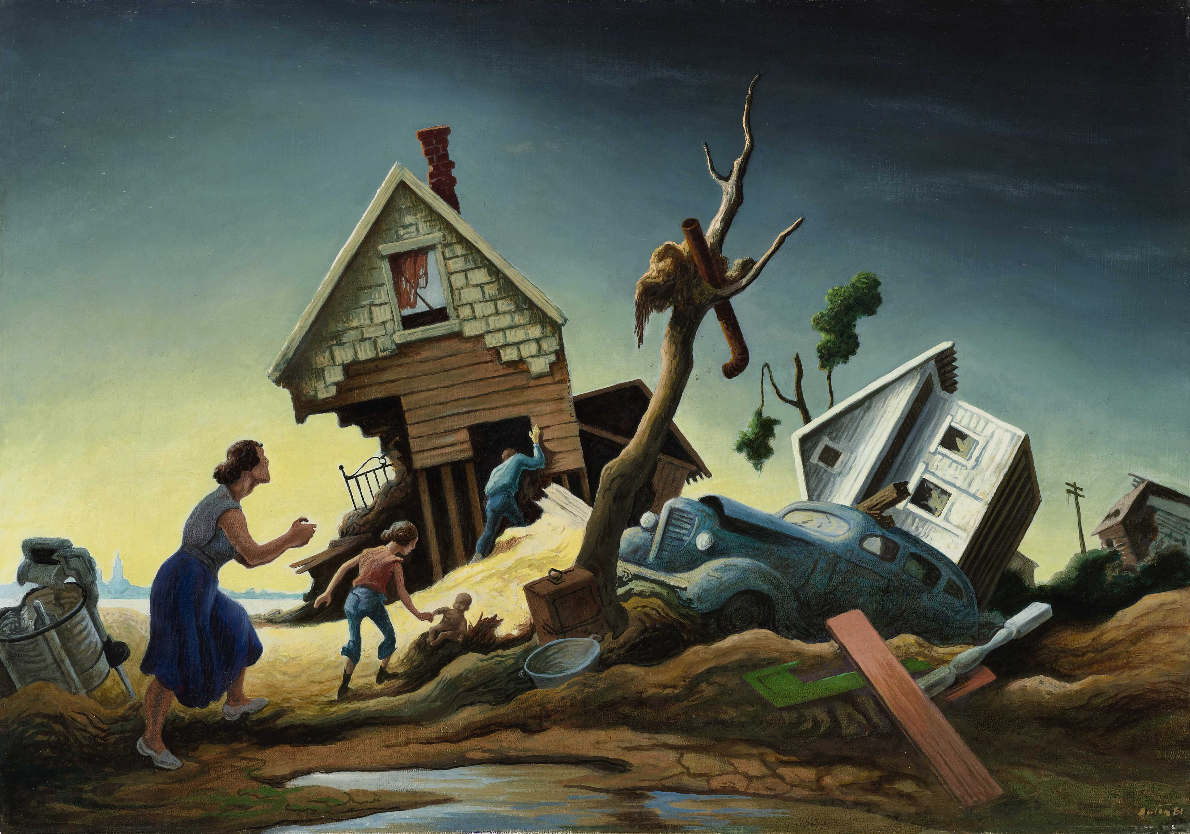
Prompt: What is an important idea from this text? Start by stating your claim. Support your claim and come to a consensus.
TEACHER COLLECTS LANGUAGE SAMPLE SPF 1.0
STUDENT VISUAL TEXT
Notes:
Display the Student Visual Text
Direct students to use their Think Time
As the students play the game, the teacher listens and selects two students who will replay the game in front of the class to serve as models.
This is an opportunity to capture a language sample.

Slide 49
CONSTRUCTIVE CONVERSATION
FISHBOWL MODEL
PROMPT: What is an important idea from this text? Start by stating your claim. Support your claim and come to a consensus.
Listen actively to what two partners say to each other.
FORMATIVE ASSESSMENT– TEACHER COLLECTS LANGUAGE SAMPLE SPF 1.0
Notes:
The two selected students will replay the game in front of the class and serve as models.
Student Progress Form (SPF)-­‐‑ Constructive Conversation Language Sample The teacher will collect a language sample from the two students on the Student Progress Form (SPF)-­‐‑ Constructive Conversation Language Sample to be used in Lesson 2. The language sample must be at least four turns in length. (Each turn includes both Partner A and B sharing

Slide 50
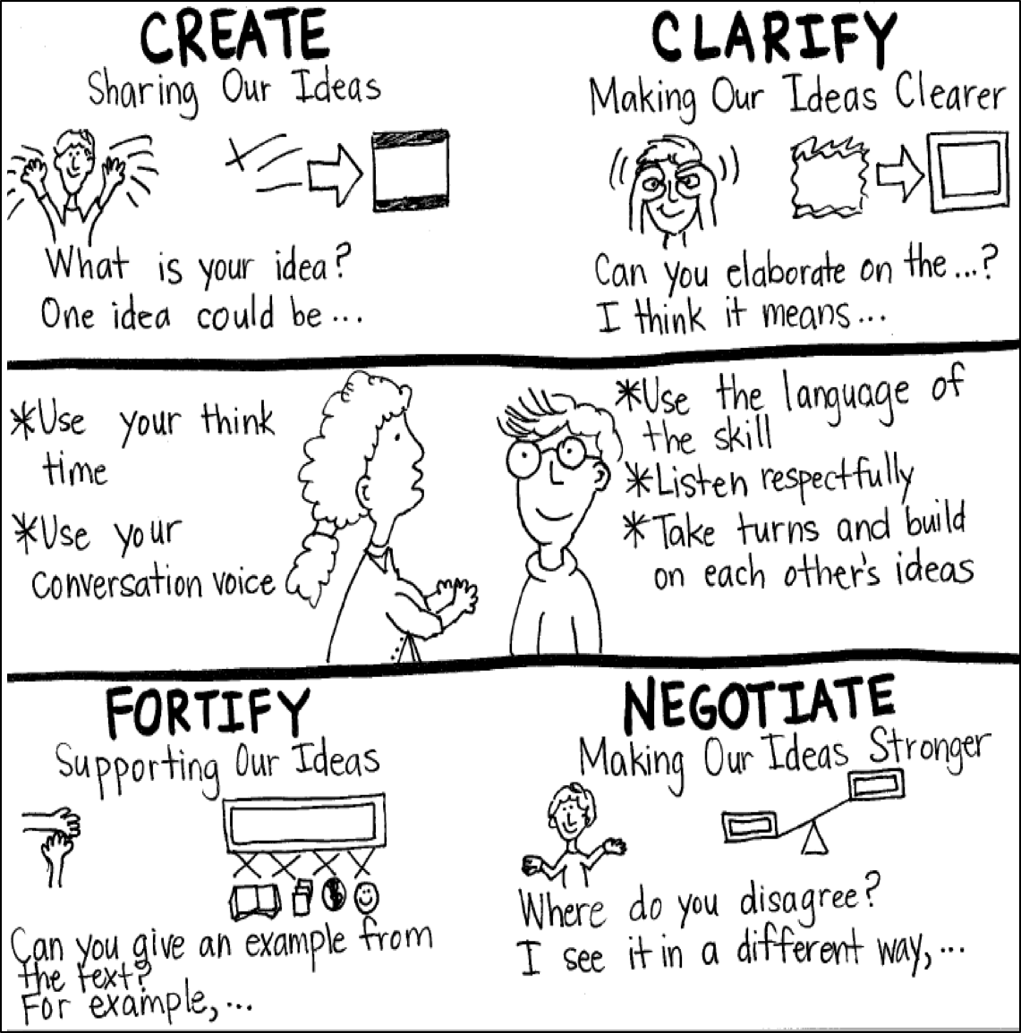
Model Creating Class Constructive Conversation Poster
Sample
Notes:
Teacher models creating a Constructive Conversation Poster. This slide is a resource. Teacher elicits student responses to help student develop a poster that illustrates their understanding of the NEGOTIATE skill and conversation norms.

Slide 51
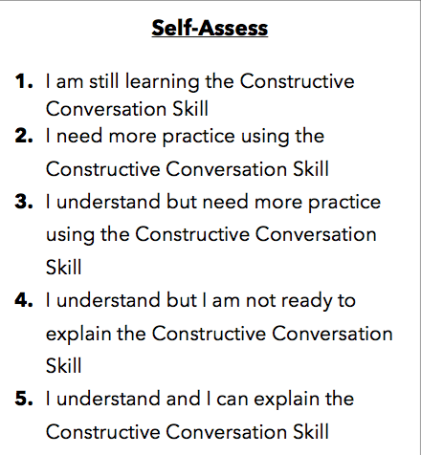
Notes:
Teacher will review the Constructive Conversation Skill NEGOTIATE
Students will self-assess answering the prompt
Teacher may select a conversation pair to share out.
EXAMPLE:
Student: I rated myself a 3 because…
Teacher: What can you do to move to a 4?

Slide 52
Teacher Resources

Slide 53
NEGOTIATE Non-Model Revision

